Slide 1
Seminar 3: Wellbeing
Flinders Psychology Students Association presents…
Notes:
Seminar 3: Wellbeing
Welcome​
Presenters Introduction
Mark Letheby – FPSA President
FPSA Introduction
On campus student association which represents students and faculty ​
Offer an array of services aimed at benefiting and enriching the student experience​
Student representation​
Social events​
General/welfare support​
Educational/careers events and development opportunities​
Merch​
Today’s presentation is on Wellbeing

Slide 2
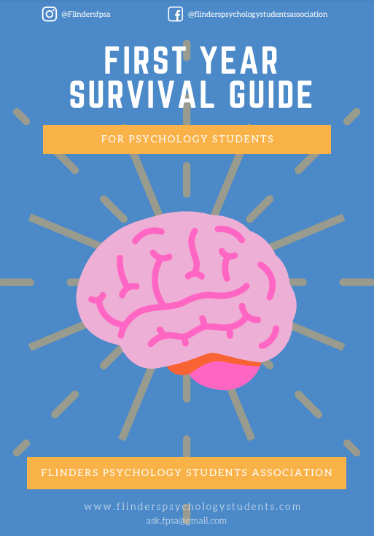
About FPSA
F.P.S.A
Flinders Psychology Students’ Association
First Year Representation
FPSA Contact
On campus student association
Services:
Student representation
Social events
General/welfare support
Educational/careers events and development opportunities
Merch (link below)
Support first year students in any way possible
Liaise between students and FPSA
Work with faculty to enrich first year experience
Contact
ask@flindersfpsa.com
Rm SSN101
ask@flindersfpsa.com
flinderspsychologystudents.com
@flindersfpsa
@flinderspsychologystudentsassociation
@flinderspsychstudents&alumni (Facebook group)
https://discord.gg/FWRMTkaSNK
@FlindersFPSA
@flinderspsychologystudents’association(fpsa)
@flindersfpsa
First Year Survival Guide download page: https://www.flinderspsychologystudents.com/first-year-survival-guide
https://www.flinderspsychologystudents.com/store
*more colours

Slide 3
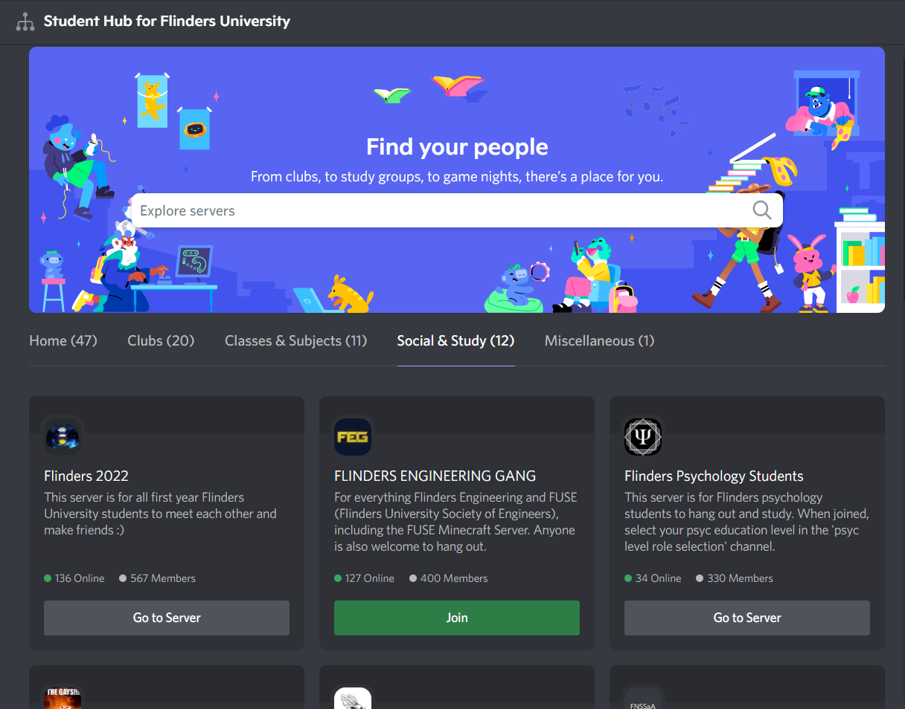
Flinders Psychology Students Discord
Interact online with peers in the ‘Flinders Psych Students & Alumni’ Discord server, which is an online community platform consisting of many themed chats (aka channels) all in one place. For example, there are:
Psychology university topic chats
Support chats
Social chats (e.g., ‘lounge chatting’, memes, pets and pictures, and gaming)
Voice chat rooms
FPSA posts up news and events on the platform, so you can stay updated with what is happening for psychology students.
Join the Discord server via the student hub for Flinders University students: https://discord.gg/FWRMTkaSNK
The student hub is where you will find an index of Flinders University student-made discord servers to join.
Notes:
Join the ‘Flinders Psych Students & Alumni’ Discord server and interact with peers in the psychology student community!
The Discord server is an online community platform consisting of many themed chats (aka channels) all in one place. The server has psychology university topic chats, support chats, and social chats (e.g., ‘lounge chatting’, memes, pets and pictures, and gaming). There are also voice chat rooms where you can hang out or study with peers online. FPSA also posts up news and events on the platform, so you can stay updated with what is happening for psychology students.
You can join the Discord server via the student hub for Flinders University students, which is a place where you will find an index of Flinders University student-made discord servers to join. Click on the link listed to join: https://discord.gg/FWRMTkaSNK .You will be asked to verify your Flinders email when joining the Flinders University Hub. Once you have joined the Flinders University Hub, search for ‘Flinders Psychology Students & Alumni’ and click ‘join’ to be a part of the online psychology student community!

Slide 4
Session Aims
Discuss the topic of wellbeing, giving you access to easily actionable tools!
Leveraging your university experience
Overview
Student lifecycle
Factors of student success
University services
Mindfulness
What is mindfulness?
The benefits of mindfulness
What does the research say?
The Four Foundations of Mindfulness
What these foundations achieve
The pillars of health (and therefore wellbeing)
Sleep
Diet and nutrition
Exercise
Social connection
Mindset
Notes:
Session Aims
Discuss the topic of wellbeing, giving you access to a variety of actionable tools!
Leveraging your university experience
Overview
Student Lifecycle
Factors of Student Success
University Services
Mindfulness
What is mindfulness?
The benefits of mindfulness
What does the research say?
The Four Foundations of Mindfulness
What these foundations achieve
The pillars of health (and therefore wellbeing)
Sleep
Diet and nutrition
Exercise
Social engagement
Mindset

Slide 5
Wellbeing
Wellbeing is fundamental for success at University, but more importantly, your quality of life!
This seminar will aim to break down the most readily available actionable tools at your disposal:
Leveraging your university experience
Mindfulness
The pillars of health (and therefore wellbeing)
Notes:
Wellbeing
Wellbeing is fundamental for success at University, but more importantly, your quality of life!
This seminar will aim to break down the most readily available actionable tools at your disposal:
Leveraging your university experience
Mindfulness
The pillars of health (and therefore wellbeing)

Slide 6
Leveraging Your
University Experience
Overview
Student Lifecycle
Factors of Student Success
University Services
Notes:
Leveraging Your University Experience
Overview
Student Lifecycle
Factors of Student Success
University Services

Slide 7
Overview
This section will discuss the university experience, and how this can be maximized.
Purpose
Why Is This Important?
To give you an overview of the student life cycle
Demonstrate that this is a dynamic process
Discuss the factors of student success
The factors deemed most important by the literature
Inform you about the student services available at university
Success at university is obviously extremely important for wellbeing
Knowledge of the student lifecycle and factors of student success can enhance your successfulness and thus wellbeing
Notes:
Overview
This section will discuss the university experience, and how this can be maximized
Purpose
To give you an overview of the student life cycle
Demonstrate that this is a dynamic process
Discuss the factors of student success
The factors deemed most important by the literature
Inform you about the student services available at university
Why Is This Important?
Success at university is obviously extremely important for wellbeing
Knowledge of the student lifecycle and factors of student success can enhance your successfulness and thus wellbeing

Slide 8
The student life cycle is the process which students undertake at university, there are 8 steps which span the entire experience from pre-enrollment to post graduation.
8 Steps
Why Is This Important?
1. Engagement
2. Recruitment
3. Application/Admission
4. Orientation/Enrollment
5. Studentship
Academic
Student life
Civic engagement
6. Graduation
7. Career Preparation
8. Alumni
These steps are not necessarily experienced linearly. Many span over multiple sections of the process.
It demonstrates that the university experience is a dynamic process
Your experience will continually change over the life cycle
There will be pressure points, during this time we must pay close attention to our wellbeing and take key steps
We need to know how to leverage ourselves across the process
First year students
Amid orientation
Amid studentship
Beginning career preparation
Notes:
Student Life Cycle
The student life cycle is the process which students undertake at university, there are 8 steps which span the entire experience from pre-enrollment to post graduation
8 Steps
1. Engagement
Initial engagement with the university (thinking about attending university).
2. Recruitment
Process of actively researching potential universities
3. Application/Admission
Actively applying for university and receiving the outcome of your application.
4. Orientation/Enrollment
The administrative, academic, and extra-curricular activities which a first-year student engages with.
5. Studentship
The activities that a student engages with to ‘transform’ them intellectually and personally and allow them to emerge as engaged ‘citizen scholars’.
Academic
Academic experiences in and outside the classroom, such as lectures, tutorials, study, and other elements which enhance the intellectual experience of the students.
Student life
Activities and experiences involved on the social and logistical side of being a student. These include both co-curricular activities and on-campus student life.
Civic engagement
Activities that enhance your standing as a citizen at both University and in the broader community – for instance, placement.
6. Graduation
The ceremonial highpoint in university life
7. Career Preparation
Takes place throughout all three stages of the life cycle and includes the activities that engage students in thinking about, gaining experience in, and preparing for their post-study careers.
8. Alumni
Activities that build loyalty to the University while in college and post-study activities as alumni.
These steps are not necessarily experienced linearly. Many span over multiple parts of the process
Why Is This Important?
It demonstrates that the university experience is a dynamic process
Your experience will continually change over the life cycle
There will be pressure points, during this time we must pay close attention to our wellbeing and take key steps
We need to know how to leverage ourselves across the process
First year students
Amid orientation
Amid studentship
Beginning career preparation

Slide 9
There will be times during the student life cycle that are particularly more difficult, these are key times that require appropriate action
The Pressure Points
What To Do?
The university experience will fluctuate between highs and lows
Low points are known as pressure points
Pressure points:
Week 1 – 2: The start of the semester
It can be difficult to get into the swing of things
Week 5 – 8: Halfway through the Semester (just prior to the break)
Census date has passed
Feedback has been given
Assessments are mounting
Week 11 – 12: The end of the semester (leading up to and including the exam period)
Assessments are mounting
During pressure points, we must pay careful attention to our wellbeing
Utilize wellbeing resources!
We can also take some key steps to overcome these pressure points
Week 1 -2
Engage with the course
Seek support if needed
Week 5 – 8
Seek support/engage with support
Week 11 – 12
Seek support/engage with support
Notes:
"Student Life Cycle − Pressure Points"
There will be times during the student life cycle that are particularly more difficult
The Pressure Points
The university experience will fluctuate between highs and low
Low points are known as pressure points
Pressure points:
At the beginning of each year
Halfway through the Semester (just prior to the mid semester break)
At the end of the semester (exam period)
What To Do?
During pressure points, we must pay careful attention to our wellbeing
Utilize available resources!

Slide 10
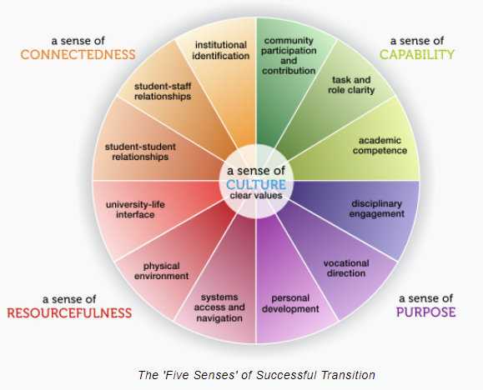
The Factors of student success provide a guideline for how to leverage ourselves across the university life cycle. A university should provide these factors, we just need to tap into them!
Factors of Success
A sense of connectedness
Feeling connected with the university
A sense of capability
Feeling capable at handling university
A sense of purpose
Feeling there is a purpose to university
A sense of resourcefulness
Feeling that the university provides the necessary resources
A sense of academic culture
Feeling there is a sense of academic culture
Notes:
Factors of Student Success – Life Cycle
The Factors of student success provide a guideline for how to leverage ourselves across the university life cycle. A university should provide these factors, we just need to tap into them!
Factors of Success
A sense of connectedness
Feeling connected with the university
A sense of capability
Feeling capable at handling university
A sense of purpose
Feeling there is a purpose to university
A sense of resourcefulness
Feeling that the university provides the necessary resources
A sense of academic culture
Feeling there is a sense of academic culture

Slide 11
This is how one can leverage the factors of student success during first year and third year through your courses
Five Senses | First Year Students | Third Year Students
Connectedness | Develop connection with colleagues by engaging in facilitated small group activities. | Develop connection with other third year colleagues, thus helping to facilitate an alumni community.
Capability | Build capability (course knowledge) by properly engaging in guided assessment tasks. | Build capability by enhancing not only academic skills, but also the important graduate attributes identified by employers, industry groups, and relevant professional bodies.
Purpose | Explore a sense of purpose, by understanding why you are at university and by articulating personal goals. | Explore a sense of purpose, by articulating career goals and clarifying commitment to further study after graduation.
Resourcefulness | Develop resourcefulness by learning effective time management, interdependent learning and help seeking skills. | Develop resourcefulness by learning effective time management, interdependent learning and help seeking skills.
Academic Culture | Learn about academic culture, including academic integrity, from a later year colleague who has successfully navigated the terrain. | Embed yourself in the academic culture by connecting more meaningfully with the staff and students of the discipline, and by developing a sense of professional identity.
Note:
Your courses should facilitate these factors of success, so properly engage with these opportunities when they arise.
Notes:
Factors of Student Success – Courses
This is how one can leverage the factors of student success during first year and third year through your courses
See slide!

Slide 12
Exercise: Factors of Student Success
How can we leverage the factors of student success outside of our classes?
Connectedness | Capability | Purpose | Resourcefulness | Academic Culture
Notes:
Exercise: Factors of Student Success
How can we leverage the factors of student success outside of our classes?
Fill in table with ideas/answers.

Slide 13
Example: Factors of Student Success
Some examples of how we can leverage the factors of student success outside of our classes
Connectedness | Capability | Purpose | Resourcefulness | Academic Culture
Join student club/associations Attend university social events Instigate and engage with study groups | Access University Services 2022 PSYC1102 Seminar Series - Seminar 1: Study Strategies Flinders Horizon Award Workshops Manage wellbeing | 2022 PSYC1102 Seminar Series - Seminar 2: Job Applications Flinders Horizon Award Workshops Self-discovery | Access University Services 2022 PSYC1102 Seminar Series - Seminar 1: Study Strategies Flinders Horizon Award Workshops | Join student club/associations Attend university social events
Notes:
Example: Factors of Student Success
Some examples of how we can leverage the factors of student success outside of our classes
See slide!

Slide 14
There is an extensive list of health and wellbeing services at Flinders University
Health and Wellbeing Services
Health services
Counseling
Disability support
Mindful yoga
Meditation
Prayer rooms
Oasis Online
Ally Network
Equal opportunity advisors
Sports and fitness
Conversation groups
Oasis Community and Wellbeing Centre
Good Vibes Experiment
Learn about mental fitness
Self-help library
Free legal advice
Be Well Plan
Chill and connect with chaplains
Flinders community market
Wellbeing Ambassador Program
Student Health and Wellbeing blog
Notes:
University Services
There is an extensive list of health and wellbeing services at Flinders University
Health and Wellbeing Services
Health services
Counseling
Disability support
Mindful yoga
Meditation
Prayer rooms
Oasis Online
Ally Network
Equal opportunity advisors
Sports and fitness
Conversation groups
Oasis Community and Wellbeing Centre
Good Vibes Experiment
Learn about mental fitness
Self-help library
Free legal advice
Be Well Plan
Chill and connect with chaplains
Flinders community market
Wellbeing Ambassador Program
Student Health and Wellbeing blog
Link: https://students.flinders.edu.au/support

Slide 15
There is an extensive list of study and learning, and financial support and assistance services at Flinders University
Study and Learning Services
Financial Support and Assistance
Study support
Academic advocacy
Studiosity
Mindfulness for Academic Success
Library
Book a librarian
FLO help
Learning Lounge
Online study guides
Student representation
Studyology
Scholarships
Financial advocacy
Assistance with tax returns
Interest free loans
Emergency financial assistance
FUSA development grants
International student support package
Notes:
University Services
There is an extensive list of study and learning, and financial support and assistance services at Flinders University
Study and Learning Services
Study support
Academic advocacy
Studiosity
Mindfulness for Academic Success
Library
Book a librarian
FLO help
Learning Lounge
Online study guides
Student representation
Studyology
Financial Support and Assistance
Scholarships
Financial advocacy
Assistance with tax returns
Interest free loans
Emergency financial assistance
FUSA development grants
International student support package

Slide 16
What is mindfulness?
The benefits of mindfulness
What does the research say?
The Four Foundations of Mindfulness
What these foundations achieve
Notes:
Mindfulness
What is mindfulness?
The benefits of mindfulness
What does the research say?
The Four Foundations of Mindfulness
Key concepts
Simple practices

Slide 17
What Is Mindfulness?
“A mental state achieved by focusing one's awareness on the present moment, where one acknowledges and accepts their bodily sensations, feelings and thoughts in a non-judgmental manner”.
Essentially, mindfulness is awareness of what is currently happening, without being carried away by it.
Notes:
What Is Mindfulness?
“A mental state achieved by focusing one's awareness on the present moment, where one acknowledges and accepts their bodily sensations, feelings and thoughts in a non-judgmental manner”.
Essentially, mindfulness is awareness of what is currently happening, without being carried away by it.

Slide 18
What Is Mindfulness?
“A mental state achieved by focusing one's awareness on the present moment, where one acknowledges and accepts their bodily sensations, feelings and thoughts in a non-judgmental manner”.
Essentially, mindfulness is awareness of what is currently happening, without being carried away by it.
Notes:
What Is Mindfulness?
“A mental state achieved by focusing one's awareness on the present moment, where one acknowledges and accepts their bodily sensations, feelings and thoughts in a non-judgmental manner” .
Essentially, mindfulness is awareness of what is currently happening, without being carried away by it.
Key Elements:
Awareness of the present moment
Being in the here and now
Not focusing on the past or future
Non-judgmental mannerism
We only acknowledge and accept
It is about being aware of what is happening, not reacting to it

Slide 19
The Benefits of Mindfulness
The practice of mindfulness allows us to become more awake and less emotionally reactive.
Being more awake means that we can enjoy and more fully experience what is currently happening.
Being less emotionally reactive means, we suffer less when something bad happens.
So, mindfulness enhances the good times and mitigates the bad times.
Notes:
The Benefits of Mindfulness
The practice of mindfulness allows us to become more awake and less emotionally reactive.
Being more awake means that we can enjoy and more fully experience what is currently happening.
Being less emotionally reactive means, we suffer less when something bad happens.
So, mindfulness enhances the good times and mitigates the bad times.

Slide 20
Extensive research on adults has consistently shown that mindfulness is effective for reducing stress, anxiety, depression, and other challenges too.
Notes:
What Does the Research Say?
Extensive research on adults has consistently shown that mindfulness is effective for reducing stress, anxiety, depression, and other challenges too.

Slide 21
Extensive research on adults has consistently shown that mindfulness is effective for reducing stress, anxiety, depression, and other challenges too.
Notes:
What Does the Research Say?
Extensive research on adults has consistently shown that mindfulness is effective for reducing stress, anxiety, depression, and other challenges too.
Research has extensively and consistently shown that it is effective.
Mindfulness works!
Note:
Further research is needed for adolescents
Appears to be the case that effective mindfulness approaches varies for adolescents in comparison to adults
Different tools are needed!

Slide 22
1. The Body
2. Feelings
3. The Mind
4. Categories of Experience
Notes:
The Four Foundations of Mindfulness
There are 4 foundations of mindfulness. These are based upon a Buddhist Discourse.
These foundations are mindfulness of the:
1. The Body
2. Feelings
3. The Mind
4. Categories of Experience

Slide 23
The Body
How To Master
The most important component of mindfulness
The body is almost always with us:
This makes practice easily accessible
This means the body is the best way to cultivate mindfulness
There are different arenas of the body which we can pay attention to
The breath
This is the best place to start
Posture
Sensations
Walking
General activities
Start with mindfulness of the breath
Pay attention to the breath
Can be difficult due to wondering of the mind
Best to be aware of your entire body rather than just your breath
This allows the breath to more naturally occur in the background
Other arenas
Posture
Simply awareness of our posture
If we are standing, know that we are standing
Sensations
Awareness of pressure, temperature, texture, etc.
Notes:
Foundation 1: The Body
The Body
The most important component of mindfulness
The body is almost always with us:
This makes practice easily accessible
This means the body is the best way to cultivate mindfulness
There are different arenas of the body which we can pay attention to
The breath
This is the best place to start
Posture
Sensations
Walking
General activities
How To Master
Start with mindfulness of the breath
Pay attention to the breath
Can be difficult due to wondering of the mind
Best to be aware of your entire body rather than just your breath
This allows the breath to more naturally occur in the background
Other arenas
Posture
Simply awareness of our posture
If we are standing, know that we are standing
Sensations
Awareness of pressure, temperature, texture, etc.

Slide 24
Feelings
How To Master
Each feeling arises with a feeling tone
This is the critical thing to be aware of
Feeling tones that arise without our awareness create certain conditions
Unpleasant tones cause aversion
Neutral tones cause delusion (inattention)
Pleasant tones cause desire/wanting
Unpleasant tones
Suffering in and of itself
Neutral tones
Inhibit wakefulness
Pleasant tones
Can be problematic as they cause desire, yet everything is impermeant
This leads to suffering
Be aware of the tones that are associated with different feelings
Each time a feeling arises, determine the tone and realize what this means
In the case of strong unpleasant or pleasant tones:
We cannot help but be aware of the tone of these feelings
Instead try to focus on the experience of these feelings and what they entail
Bodily sensations, thoughts, etc.
Realize that these experiences do not affect our awareness
Therefore, they do not need to affect our mood
Notes:
Foundation 1: The Body
Feelings
Each feeling arises with a feeling tone
This is the critical thing to be aware of
Feeling tones that arise without our awareness create certain conditions
Unpleasant tones cause aversion
Neutral tones cause delusion (inattention)
Pleasant tones cause desire/wanting
Unpleasant tones
Suffering in and of itself
Neutral tones
Inhibit wakefulness
Pleasant tones
Can be problematic as they cause desire, yet everything is impermeant
This leads to suffering
How To Master
Be aware of the tones that are associated with different feelings
Each time a feeling arises, determine the tone and realize what this means
In the case of strong unpleasant or pleasant tones:
We cannot help but be aware of the tone of these feelings
Instead try to focus on the experience of these feelings and what they entail
Bodily sensations, thoughts, etc.
Realize that these experiences do not affect our awareness
Therefore, they do not need to affect our mood

Slide 25
The Mind
How To Master
Some mindsets are beneficial, and some are not
This is the critical thing to be aware of
Mindfulness of the mind allows us to determine our mindsets and discern between which are beneficial and which are not
Beneficial mindsets
Are wholesome
Non-beneficial mindsets
Are unwholesome
Be aware of your mindset
Discern between those that are beneficial and those that are not
Intermittently check in: “what is my current attitude?”
Know the common experiences which people encounter when beginning mindfulness
The mind is a crazy and overwhelming place
You will experience unwholesome aspects of yourself
Remember, we are not here to judge
Wholesome mindsets
Through awareness we can cultivate
Unwholesome mindsets
Through awareness, we can detach
One good phrase to utilize: “this is nature”
Notes:
Foundation 1: The Body
The Mind
Some mindsets are beneficial, and some are not
This is the critical thing to be aware of
Mindfulness of the mind allows us to determine our mindsets and discern between which are beneficial and which are not
Beneficial mindsets
Are wholesome
Non-beneficial mindsets
Are unwholesome
How To Master
Be aware of your mindset
Discern between those that are beneficial and those that are not
Intermittently check in: “what is my current attitude?”
Know the common experiences which people encounter when beginning mindfulness
The mind is a crazy and overwhelming place
You will experience unwholesome aspects of yourself
Remember, we are not here to judge
Wholesome mindsets
Through awareness we can cultivate
Unwholesome mindsets
Through awareness, we can detach
One good phrase to utilize: “this is nature”

Slide 26
Categories of Experience
How To Master
The Buddhist’s categorize different types of experience
For each category of experience, there is something to be learnt
Being mindful of these categories can facilitate these learnings
This is the final foundation for a reason
Although extremely important, for some starting out, this foundation is the further reading of mindfulness
Explore once mastery of the other foundations have been achieved
Chose a category of experience and be mindful of this
The Seven Foundations of Enlightenment
The Four Noble Truths
The components of these categories indicate which parts of ourselves need work
This is what we must be mindful of
Notes:
Foundation 1: The Body
Categories of Experience
The Buddhist’s categorize different types of experience
For each category of experience, there is something to be learnt
Being mindful of these categories can facilitate these learnings
This is the final foundation for a reason
Although extremely important, for some starting out, this foundation is the further reading of mindfulness
How To Master
Explore once mastery of the other foundations have been achieved
Chose a category of experience and be mindful of this
The Seven Foundations of Enlightenment
The Four Noble Truths
The components of these categories indicate which parts of ourselves need work
This is what we must be mindful of

Slide 27
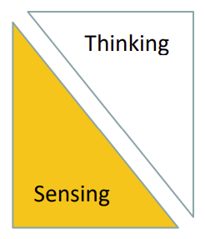
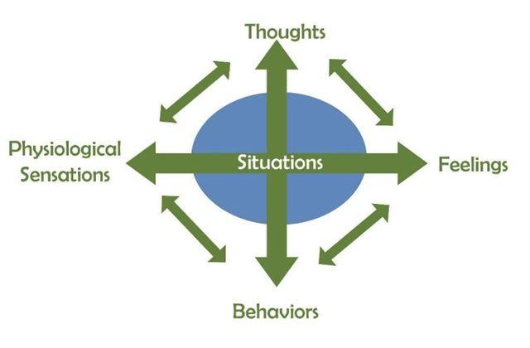
There are four key elements of mindfulness which the four foundations tap into. These elements are outlined in the PSYC3012 Mindfulness Workshop presented by Dr Catherine Johnson - Research Fellow, Flinders University - PhD, B Psych Sc (Hons), B App Sc (Physio), M App Sc (Physio).
1. Creation of Space
3. Awareness of TES
2. The Ability to Change
Between Mental Gears
4. Self Compassion
27
Notes:
"Student Life Cycle − Pressure Points"
There will be times during the student life cycle that are particularly more difficult
The Pressure Points
The university experience will fluctuate between highs and low
Low points are known as pressure points
Pressure points:
At the beginning of each year
Halfway through the Semester (just prior to the mid semester break)
At the end of the semester (exam period)
What To Do?
During pressure points, we must pay careful attention to our wellbeing
Utilize available resources!

Slide 28
Exercise: TES
You’re just about to sit down to complete an exam for a hard subject. What TES might you experience?
Thoughts | Emotions | Sensations (Bodily)
Notes:
Exercise: TES
You’re just about to sit down to complete an exam for a hard subject. What TES might you experience?
Fill in table with ideas/answers.

Slide 29
Exercise: TES
You’re just about to sit down to complete an exam for a hard subject. What TES might you experience?
Thoughts | Emotions | Sensations (Bodily)
I am going to fail What if I can’t answer any of the questions This exam is going to be so hard There is no way I am going to pass | Anxiety | Tightening/tension Heart racing
Notes:
Exercise: TES
You’re just about to sit down to complete an exam for a hard subject. What TES might you experience?
Thoughts
I am going to fail
What if I can’t answer any of the questions
This exam is going to be so hard
There is no way I am going to pass
Emotions
Anxiety
Sensations (Bodily)
Tightening/tension
Heart racing

Slide 30
The Pillars of Health
(and Therefore Wellbeing)
Sleep
Diet and nutrition
Exercise
Social connection
Mindset
Note: We are not medical professionals
This is not medical advice
You should check everything yourself first, and consult a doctor
We are simply reporting what the literature says
Notes:
The Pillars of Health (and Therefore Wellbeing)
Sleep
Diet and nutrition
Exercise
Social engagement
Mindset
Note: We are not medical professionals
This is not medical advice
You should check everything yourself first, and consult a doctor
We are simply reporting what the literature says

Slide 31
Sleep
Notes:
Sleep

Slide 32
Sleep is the bedrock for all aspects of life, most definitely including wellbeing!
The Big Picture
Consequences of Poor Sleep
The average adult needs at least 8 hours of quality sleep per night
The average adult in America gets about 6 hours of quality sleep per night
This means half the population is sleep deprived
We are living through a sleep pandemic!
Sleep quality
You want to think about sleep in terms of sleep quality, not sleep amount
Quality refers to deep, restorative sleep
Poor sleep leads to an extensive list of consequences
Poor sleep will practically impact every aspect of our lives negatively
This includes wellbeing both directly and indirectly
Direct consequences
Neuromodulator production decreases
Dopamine and serotonin levels drop
Mood plummets
Indirect consequences
Impaired cognition
University becomes more difficult
Stress increases
Notes:
Sleep – Framing
Sleep is the bedrock for all aspects of life, most definitely including wellbeing!
The Big Picture
The average adult needs at least 8 hours of quality sleep per night
The average adult in America gets about 6 hours of quality sleep per night
This means half the population is sleep deprived
We are living through a sleep pandemic!
Sleep quality
You want to think about sleep in terms of sleep quality, not sleep amount
Quality refers to deep, restorative sleep
Consequences of Poor Sleep
Poor sleep leads to an extensive list of consequences
Poor sleep will practically impact every aspect of our lives negatively
This includes wellbeing both directly and indirectly
Direct consequences
Neuromodulator production decreases
Dopamine and serotonin levels drop
Mood plummets
Indirect consequences
Impaired cognition
University becomes more difficult
Stress increases

Slide 33
Do not fear, there are many simple steps that can be taken to improve sleep!
How To Improve Sleep
1. Get Morning Light
Morning light acts as the anchor for our circadian rhythms
Light is essentially our cue to wake up
Sunlight is critical
Artificial/phone lights do not cut it
2. Regularity
Go to sleep and wake up at the same time every day no matter what
This will maximize quality
Do not sleep in on the weekends!
3. Avoid Evening Light
Light delays melatonin which is the sleep hormone
Use low level warm lights instead of bright overhead lights
Lamps are your friend!
4. Cold Is Best
The temperature of our brain needs to drop about 2 degrees C before we can effectively sleep
Thus, it is easier to fall asleep and stay asleep in a cold environment
This can be hacked by achieving vasodilation
Hot (yes hot) showers are your friend!
Notes:
Sleep – How to Improve
Do not fear, there are many simple steps that can be taken to improve sleep!
How To Improve Sleep
1. Get Morning Light
Morning light acts as the anchor for our circadian rhythms
Light is essentially our cue to wake up
Sunlight is critical
Artificial/phone lights do not cut it
2. Regularity
Go to sleep and wake up at the same time every day no matter what
This will maximize quality
Do not sleep in on the weekends!
3. Avoid Evening Light
Light delays melatonin which is the sleep hormone
Use low level warm lights instead of bright overhead lights
Lamps are your friend!
4. Cold Is Best
The temperature of our brain needs to drop about 2 degrees C before we can effectively sleep
Thus, it is easier to fall asleep and stay asleep in a cold environment
This can be hacked by achieving vasodilation
Hot (yes hot) showers are your friend!

Slide 34
Diet & Nutrition
Notes:
Diet & Nutrition

Slide 35
Diet & Nutrition directly impacts our mood, both chronically and acutely
Chronic
Acute
Obviously, diet and nutrition impacts our physical health and mental wellbeing
Our choices have lasting consequences, so if we want to take our wellbeing seriously, then we must take our diet and nutrition seriously too!
What we eat, can impact our short-term state/mood
Foods that promote dopamine
Make us feel good
Increase energy and motivation
Foods that promote serotonin
Makes us feel comfortable and bliss
Increases ability to relax
Structuring food intake
Foods which promote dopamine might be best consumed earlier during the day
Foods which promote serotonin might be best consumed later during the day
Notes:
Diet & Nutrition - Framing
Diet & Nutrition directly impacts our mood, both chronically and acutely
Chronic
Obviously, diet and nutrition impacts our physical health and mental wellbeing
Our choices have lasting consequences, so if we want to take our wellbeing seriously, then we must take our diet and nutrition seriously too!
Acute
What we eat, can impact our short-term state/mood
Foods that promote dopamine
Make us feel good
Increase energy and motivation
Foods that promote serotonin
Makes us feel comfortable and bliss
Increases ability to relax
Structuring food intake
Foods which promote dopamine might be best consumed earlier during the day
Foods which promote serotonin might be best consumed later during the day

Slide 36
Diet & Nutrition - Framing
Diet & Nutrition directly impacts our mood, both chronically and acutely
Diet & Nutrition
Everyone’s body is different
Optimal diet will vary from individual to individual
There is no once size fits all!
Do your research and explore what works best for you!
However, there are some common factors of a good diet:
Low in processed foods
High in vitamins and nutrients
High in beneficial amino acids
High in Omega 3 fatty acids
Incorporates calorie restriction
Incorporates probiotic foods
Incorporates organic whole foods
Sufficient water intake is absolutely critical for our bodies to operate properly
Minimum amounts:
3.7L for men
2.7L for women
About 20% of this will come from diet
So about 8 – 12 cups of water is necessary
Notes:
Diet & Nutrition – Framing
Diet & Nutrition directly impacts our mood, both chronically and acutely
Diet & Nutrition
Everyone’s body is different
Optimal diet will vary from individual to individual
There is no once size fits all!
Do your research and explore what works best for you!
However, there are some common factors of a good diet:
Low in processed foods
High in vitamins and nutrients
High in beneficial amino acids
High in Omega 3 fatty acids
Incorporates calorie restriction
Incorporates probiotic foods
Incorporates organic whole foods
Water Intake
Sufficient water intake is absolutely critical for our bodies to operate properly
Minimum amounts:
3.7L for men
2.7L for women
About 20% of this will come from diet
So about 8 – 12 cups of water is necessary

Slide 37
Diet & Nutrition - Aspects
Diet & Nutrition directly impacts our mood, both chronically and acutely
Processed Foods
Vitamins and Nutrients
Notes:
Diet & Nutrition - Aspects
Diet & Nutrition directly impacts our mood, both chronically and acutely
Processed Foods
Processed foods contain an array of nasty things
Processed sugars
Our bodies have not evolved to deal with processed sugars
Spike insulin
Not good for chronic health
Cause unconscious cravings
Artificial sweeteners
Most disrupt the microbiome
Stevia may be the exception
Emulsifiers
Strip the mucosal lining of the gut, limiting important signaling
Vitamins and Nutrients
Vitamin D
Critical for serotonin production
Micronutrients
Supports health and longevity
Dark leafy green vegetables are your friends!
Spinach, kale etc.
The literature also supports the use of multivitamins
Selenium
Critical for thyroid functioning
Important for energy
Quite difficult to come by
Found in very limited amounts in animal products and mushrooms
Best source by far is Brazil nuts
Do not overconsume
Only need a couple per day

Slide 38
Diet & Nutrition directly impacts our mood, both chronically and acutely
Omega 3
Amino acids are the building blocks of many things in our body
Muscles
Neurochemicals in the brain
Important for wellbeing
L Tyrosine
Found in high protein and fat foods
Precursor to dopamine
Increases mood, elevation and alertness
L Carnitine
Found in meat (beef in particular)
Has impressive effects on depression
The omega 3 to omega 6 fatty acid ratio has a profound effect on depression and mood
A higher omega 3 count (relative to Omega 6) will have a positive effect on mood
Studies have found that 1000mg of EPA (one of several omega 3 fatty acids), is just as effective as prosaic (an SSRI) in combatting depression
Effective for both anxiety related depression and lethargic depression
Sources of Omega 3
Best found in fish and fish oil
Also found in nuts (particularly walnuts) and seeds
Notes:
Diet & Nutrition – Aspects
Diet & Nutrition directly impacts our mood, both chronically and acutely
Beneficial Amino Acids
Amino acids are the building blocks of many things in our body
Muscles
Neurochemicals in the brain
Important for wellbeing
L Tyrosine
Found in high protein and fat foods
Precursor to dopamine
Increases mood, elevation and alertness
L Carnitine
Found in meat (beef in particular)
Has impressive effects on depression
Omega 3
The omega 3 to omega 6 fatty acid ratio has a profound effect on depression and mood
A higher omega 3 count (relative to Omega 6) will have a positive effect on mood
Studies have found that 1000mg of EPA (one of several omega 3 fatty acids), is just as effective as prosaic (an SSRI) in combatting depression
Effective for both anxiety related depression and lethargic depression
Sources of Omega 3
Best found in fish and fish oil
Also found in nuts (particularly walnuts) and seeds

Slide 39
Diet & Nutrition - Aspects
Diet & Nutrition directly impacts our mood, both chronically and acutely
Most prominently seen in the form of intermittent fasting
Most common protocol is 16:8
8 hour eating window
For instance, 12pm – 8pm
16 hour fasting window
For instance, 8pm – 12pm
Fantastic for longevity
Fasted states can also increase energy and mood
Some people do not gel with these protocols, start small and work up!
Probiotics can help support a healthy microbiome
A healthy microbiome results in elevated mood, digestion, immune system functioning and healthy gut brain access
More is not better when it comes to probiotics
Sources of probiotics
Fermented foods
Probiotic supplements
Foods are best as you can better ensure you do not consume too much
Notes:
Diet & Nutrition - Aspects
Diet & Nutrition directly impacts our mood, both chronically and acutely
Calorie Restriction
Most prominently seen in the form of intermittent fasting
Most common protocol is 16:8
8 hour eating window
For instance, 12pm – 8pm
16 hour fasting window
For instance, 8pm – 12pm
Fantastic for longevity
Fasted states can also increase energy and mood
Some people do not gel with these protocols, start small and work up!
Probiotics
Probiotics can help support a healthy microbiome
A healthy microbiome results in elevated mood, digestion, immune system functioning and healthy gut brain access
More is not better when it comes to probiotics
Sources of probiotics
Fermented foods
Probiotic supplements
Foods are best as you can better ensure you do not consume too much

Slide 40
Diet & Nutrition - Aspects
Diet & Nutrition directly impacts our mood, both chronically and acutely
Unfortunately, many non-organic foods contain chemicals
Pesticides
Herbicides
These chemicals can impact our hormones and mood
So where possible, eat organic foods
However, this can be expensive
Inexpensive and fun solution?
Gardening!
Notes:
Diet & Nutrition - Aspects
Diet & Nutrition directly impacts our mood, both chronically and acutely
Organic Foods
Unfortunately, many non-organic foods contain chemicals
Pesticides
Herbicides
These chemicals can impact our hormones and mood
So where possible, eat organic foods
However, this can be expensive
Inexpensive and fun solution?
Gardening!

Slide 41
Exercise
Notes:
Exercise

Slide 42
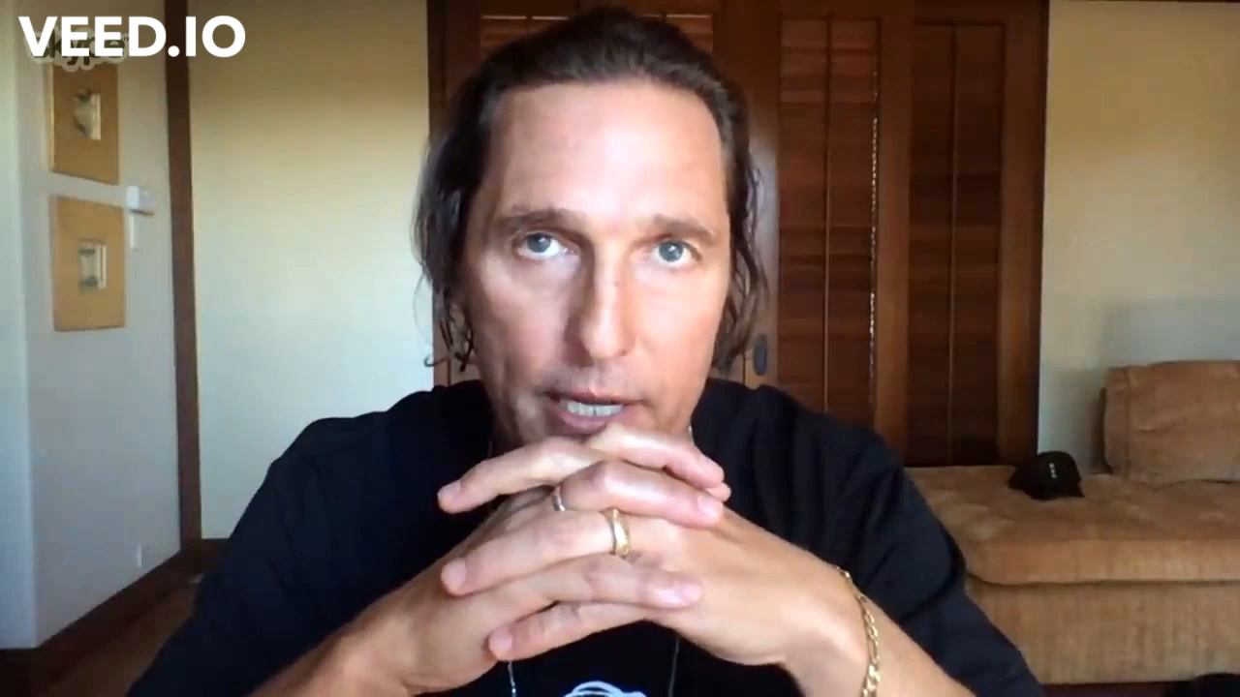
Exercise – Framing
Exercise tightly modulates stress and increases wellbeing
The Benefits of Exercise
Fantastic for health
Increases long term wellbeing
Increases short term neuromodulator production
Dopamine
Serotonin
Improves mood and makes it easier to deal with short term stress
Find what exercise works best for you!
Running
Bike riding
Yoga
Lifting weights
Notes:
Exercise – Framing
Exercise tightly modulates stress and increases wellbeing
The Benefits of Exercise
Fantastic for health
Increases long term wellbeing
Increases short term neuromodulator production
Dopamine
Serotonin
Improves mood and makes it easier to deal with short term stress
Find what exercise works best for you!
Running
Bike riding
Yoga
Lifting weights

Slide 43
Social Connection
Notes:
Social Connection

Slide 44
Social Connection
Social connection also tightly modules the stress response
Social Creatures
Human beings are social creatures
We have a strong desire to connect with others in a meaningful way
Our wellbeing can run afoul when this does not happen
Relevant for all personalities
The important thing can be the quality of our relationships
It is not always about the number
All animals (from humans to flies) contain a substance called tachykinin
Tachykinin is released when we become socially isolated
It makes us more fearful, paranoid and weakens our immune system.
It essentially acts as an internal punishment signal
It tells us we are not spending enough time engaging in meaningful social relationships or doing things which we enjoy
We really want to avoid Tachykinin!
It promotes bad functions and impairs good functions
Notes:
Social Connection
Social connection also tightly modules the stress response
Social Creatures
Human beings are social creatures
We have a strong desire to connect with others in a meaningful way
Our wellbeing can run afoul when this does not happen
Relevant for all personalities
The important thing can be the quality of our relationships
It is not always about the number
When We Don't Engage
All animals (from humans to flies) contain a substance called tachykinin
Tachykinin is released when we become socially isolated
It makes us more fearful, paranoid and weakens our immune system.
It essentially acts as an internal punishment signal
It tells us we are not spending enough time engaging in meaningful social relationships or doing things which we enjoy
We really want to avoid Tachykinin!
It promotes bad functions and impairs good functions

Slide 45
Social Connection
Social connection also tightly modules the stress response
When we engage in meaningful connection, serotonin is produced
Serotonin:
Creates feelings of wellbeing and contentedness
Has positive effects on the immune system and systems of neural repair, and synapses and other things that reinforce connections in the brain
Prevents long term neural withering
Simply through contact with people or things we are attached with
Does not need to be human connection!
Can be human animal connections or simply connection to things that delight us.
If we struggle with social relationships
Know that relationships take time
Sometimes we need to do things which we would prefer not to do
Never have we had the ability to interact with so many people before
Remember, quality over quantity
Notes:
Social Connection
Social connection also tightly modules the stress response
When We Do Engage
When we engage in meaningful connection, serotonin is produced
Serotonin:
Creates feelings of wellbeing and contentedness
Has positive effects on the immune system and systems of neural repair, and synapses and other things that reinforce connections in the brain
Prevents long term neural withering
How To Engage
Simply through contact with people or things we are attached with
Does not need to be human connection!
Can be human animal connections or simply connection to things that delight us.
If we struggle with social relationships
Know that relationships take time
Sometimes we need to do things which we would prefer not to do
Never have we had the ability to interact with so many people before
Remember, quality over quantity

Slide 46
Mindset
Notes:
Mindset

Slide 47
Mindset
Mindset is the most difficult aspect of wellbeing to master
How To Master
There is no simple solution
What the literature suggests:
Adopt a mindfulness/meditation practice
Support the other pillars of wellbeing (mindset will improve as a result)
Breathwork
Cold exposures
Gratitude practices
Directly working on mindset is a difficult thing to do
For those who are interested in putting the work in
Self-help resources
See the following slide
Notes:
Mindset
Mindset is the most difficult aspect of wellbeing to master
How To Master
There is no simple solution
What the literature suggests:
Adopt a mindfulness/meditation practice
Support the other pillars of wellbeing (mindset will improve as a result)
Breathwork
Cold exposures
Gratitude practices
Directly working on mindset is a difficult thing to do
For those who are interested in putting the work in
Self-help resources
See the following slide
Breathwork
Use of the breath is the best way to rapidly influence our mood
The physiological sigh (acute impact)
Double inhale followed by a slow exhale
Quickest way to induce a parasympathetic state
Conscious nasal breathing (chronic impact)
Deep, slow inhales and exhales through the mouth
Aim for 6 cycles a minute
That’s about 5 seconds for EACH inhale AND EACH exhale
Facilitates a parasympathetic state

Slide 48
Mindset
Mindset is the most difficult aspect of wellbeing to master
Notes:
Mindset
Mindset is the most difficult aspect of wellbeing to master
Cold Exposures
Cold showers – ice baths
Start small and work up
Your body will adapt (quickly)
Can result in 2.5 x increase in dopamine, adrenaline (and noradrenaline) for hours after the 〖"exposure" 〗^16
It essentially puts your body into an anti-depressed state where you are ready to go
Has an array of other benefits for the body and mind also
See the Wim Hof Method for more information!
Gratitude Practice
Take time to realize the things which you are grateful for
Allows you to realize the positive aspects of life even when times are tough
Helps you appreciate the small things/things that would otherwise go unnoticed
"You want to give gratitude, but also receive it!"
Putting yourself around good people which you are grateful for is also key!
Benefits:
Positive effects for serotonin
Particularly effective when written down
Studies have also shown that a gratitude practice can increase dopamine by substantial amounts

Slide 49
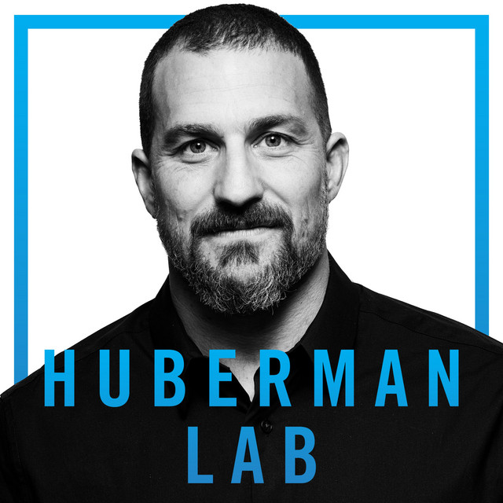
Mindset – Self Help Resources
Books
Podcasts
Health
Why We Sleep – Matthew Walker
Breath – James Nestor
The Wim Hof Method – Wim Hof
The Molecule of More – Daniel Lieberman & Michael Long
Psychology/mindset
Mindfulness: A Practical Guide to Awakening – Joseph Goldstein
12 Rules For Life – Jordan Peterson
Atomic Habits – James Clear
The 7 Habits of Highly Effective People – Stephen Covey
Thinking, Fast and Slow – Daniel Kahneman
How To Win Friends and Influence People – Dale Carnegie
Philosophy
The Daily Stoic – Ryan Holiday
Anything by Carl Jung
Anything by Friedrich Nietzsche
Everything
Huberman Lab – Andrew Huberman
Seriously, this is your one stop shop!
Notes:
Mindset – Self Help Resources
Books
Health
Why We Sleep – Matthew Walker
Breath – James Nestor
The Wim Hof Method – Wim Hof
The Molecule of More – Daniel Lieberman & Michael Long
Psychology/mindset
12 Rules For Life – Jordan Peterson
Atomic Habits – James Clear
The 7 Habits of Highly Effective People – Stephen Covey
Thinking, Fast and Slow – Daniel Kahneman
How To Win Friends and Influence People – Dale Carnegie
Philosophy
The Daily Stoic – Ryan Holiday
Anything by Carl Jung
Anything by Friedrich Nietzsche
Podcasts
Everything
Huberman Lab – Andrew Huberman
Seriously, this is your one stop shop!

Slide 50
Final Tips
We have covered a lot of information and tools - try not to feel overwhelmed by this
It may be stressful as it appears there are lots of things you should/could be doing
Just pick one thing to start with, which seems the most easiest/attractive/interesting to you
Incorporate this into your routine in small gradual steps
This is the best way to build a habit!
You will find that as you start to master one aspect of wellbeing, the others will become much easier to tackle also
Snowball effect!
Notes:
Final Tips
We have covered a lot of information and tools - try not to feel overwhelmed by this
It may be stressful as it appears there are lots of things you should/could be doing
Just pick one thing to start with, which seems the most easiest/attractive/interesting to you
Incorporate this into your routine in small gradual steps
This is the best way to build a habit!
You will find that as you start to master one aspect of wellbeing, the others will become much easier to tackle also
Snowball effect!

Slide 51
Summary:
We now have some easily accessible actionable tools to manage our wellbeing
Leveraging your university experience
Overview
Student lifecycle
Factors of student success
University services
Mindfulness
What is mindfulness?
The benefits of mindfulness
What does the research say?
The Four Foundations of Mindfulness
What these foundations achieve
The pillars of health (and therefore wellbeing)
Sleep
Diet and nutrition
Exercise
Social connection
Mindset
Notes:
Summary
We now have some easily accessible actionable tools to manage our wellbeing
Leveraging your university experience
Overview
Student lifecycle
Factors of student success
University services
Mindfulness
What is mindfulness?
The benefits of mindfulness
What does the research say?
The Four Foundations of Mindfulness
What these foundations achieve
The pillars of health (and therefore wellbeing)
Sleep
Diet and nutrition
Exercise
Social connection
Mindset

Slide 52
Questions?
Notes:
Questions?

Slide 54
References 1
1. https://www.csusm.edu/successcoaching/program/lifecycle.html
2. https://www.studentwellbeing.admin.cam.ac.uk/information-parents-undergraduates/pressure-points
3. https://emedia.rmit.edu.au/tito/content/student-lifecycle-model
4. https://students.flinders.edu.au/support
5. PSYC 3012 Mindfulness Workshop presented by Dr Catherine Johnson - Research Fellow, Flinders University - PhD, B Psych Sc (Hons), B App Sc (Physio), M App Sc (Physio)
6. 483: Four Ways to Boost Your Mindfulness Muscle | Joseph Goldstein https://open.spotify.com/episode/6SRmKOwjiHgjcrOuFeC3QJ?si=846b2e35df0e4db8
7. Book: Why We Sleep – Matthew Walker
7. How Foods and Nutrients Control Our Moods | Huberman Lab Podcast #11 https://www.youtube.com/watch?v=XfURDjegrAw&ab_channel=AndrewHuberman
9. https://www.mayoclinic.org/healthy-lifestyle/nutrition-and-healthy-eating/in-depth/water/art-20044256#:~:text=So%20how%20much%20fluid%20does,fluids%20a%20day%20for%20women
10. How Foods and Nutrients Control Our Moods | Huberman Lab Podcast #11 https://www.youtube.com/watch?v=XfURDjegrAw&ab_channel=AndrewHuberman
Notes:
References 1
See slide

Slide 55
References 2
11. How to Control Your Metabolism by Thyroid & Growth Hormone | Huberman Lab Podcast #17 https://www.youtube.com/watch?v=x7qbJeRxWGw&ab_channel=AndrewHuberman
12. Joe Rogan Experience #459 – Dr. Rhonda Patrick https://open.spotify.com/episode/1YK7KITyXL8aa8ckMYeRgg?si=N5O0twDHTKmjEdKgNYBScw
13. Using Cortisol & Adrenaline to Boost Our Energy & Immune System Function | Huberman Lab Podcast #18 https://www.youtube.com/watch?v=JPX8g8ibKFc&ab_channel=AndrewHuberman
14. Biological Influences On Sex, Sex Differences & Preferences | Huberman Lab Podcast #14 https://www.youtube.com/watch?v=J7SrAEacyf8&ab_channel=AndrewHuberman
15. Tools for Managing Stress & Anxiety | Huberman Lab Podcast #10 https://www.youtube.com/watch?v=ntfcfJ28eiU&ab_channel=AndrewHuberman
16. Book: Breath – James Nestor
17: Book: The Wim Hof Method – Wim Hof
18: Joe Rogan Experience #1842 – Andrew Huberman https://open.spotify.com/episode/2BGyj7ukaq8aA29BsA1Yuk?si=3UEAV7lFTqeQPzjf-5wb-A
Notes:
References 2
See slide

Slide 56
Thank You!!
Feel free to drop by the FPSA office during our office hours!
Room SSN101
Email
askfpsa@flindersfpsa.com
Find us on Facebook, Instagram, Discord and other social media platforms!
Notes:
And that’s a wrap!
Thank you for your time!
We’re only students so we appreciate the opportunity to be in this position, being able to speak to you like this!
I hope that this seminar has been even a little bit helpful for you.
On this slide is the important contact info for FPSA.
So feel free to drop into our office SSN1101 during office hours for absolutely anything!

Slide 57
FPSA Contact
Rm SSN101
ask@flindersfpsa.com
www.flinderspsychologystudents.com
@flindersfpsa
@flinderspsychologystudentsassociation
‘Flinders Psych Students & Alumni’ Facebook group: https://www.facebook.com/groups/flinderspsychologystudents
@FlindersFPSA
@Flinders Psychology Students' Association (FPSA)
Flinders Psych Students & Alumni server. Accessible via the student hub for Flinders University.
Flinders University student hub link: https://discord.gg/FWRMTkaSNK
Notes:
FPSA Contact Details
See slide
Click on the links on the slide to be directed to the social media pages

